Slide 1
UNIT –IV
Constraint Satisfaction Problems
By
S.Komal Kaur
Assistant Professor, CSE Dept
VCE

Slide 2
Outline
Defining Constraint Satification Problems
Example problem: Map coloring
Variations on the CSP Formalism
Cryptarithmetic
Constraint Propogation: Inference in CSP
BackTracking Search For CSPs
Local Search for CSPs
The Structure of Problems

Slide 3
Constraint Satisfaction Problems
This chapter describes a way to solve a wide variety of problems more efﬁciently.
We use a factored representation for each state: a set of variables, each of which has a value.
Allows useful general-purpose algorithms with more power than standard search algorithms

Slide 4
Constraint Satisfaction Problems
A problem is solved when each variable has a value that satisﬁes all the constraints on the variable.
A problem described this way is called a constraint satisfaction problem, or CSP.

Slide 5
Defining Constraint satisfaction problems (CSPs)
A constraint satisfaction problem consists of three components, X,D, and C:
X is a set of variables, {X1,...,Xn}.
D is a set of domains, {D1,...,Dn}, one for each variable.
C is a set of constraints that specify allowable combinations of values.

Slide 6
CSP
Each domain Di consists of a set of allowable values, {v1,...,vk} for variable Xi.
Each constraint Ci consists of a pair <scope,rel>,
where scope is a tuple of variables that participate in the constraint and rel is a relation that deﬁnes the values that those variables can take on.

Slide 7

Example: Map-Coloring
Variables WA, NT, Q, NSW, V, SA, T
Domains D_{i} = {red,green,blue}
Constraints: adjacent regions must have different colors
e.g., WA ≠ NT

Slide 8
Example
Example problem: Map coloring Suppose that, having tired of Romania, we are looking at a map of Australia showing each of its states and territories
We are given the task of coloring each region either red, green, or blue in such a way that no neighboring regions have the same color.

Slide 9
To formulate this as a CSP, we deﬁne the variables to be the regions
X = {WA,NT,Q,NSW ,V,SA,T} .
The domain of each variable is the set
Di = {red,green,blue}.

Slide 10

Example: Map-Coloring
Solutions are complete and consistent assignments, e.g., WA = red, NT = green,Q = red,NSW = green,V = red,SA = blue,T = green

Slide 11
Map Coloring
The constraints require neighboring regions to have distinct colors. Since there are nine places where regions border, there are nine constraints:

Slide 12
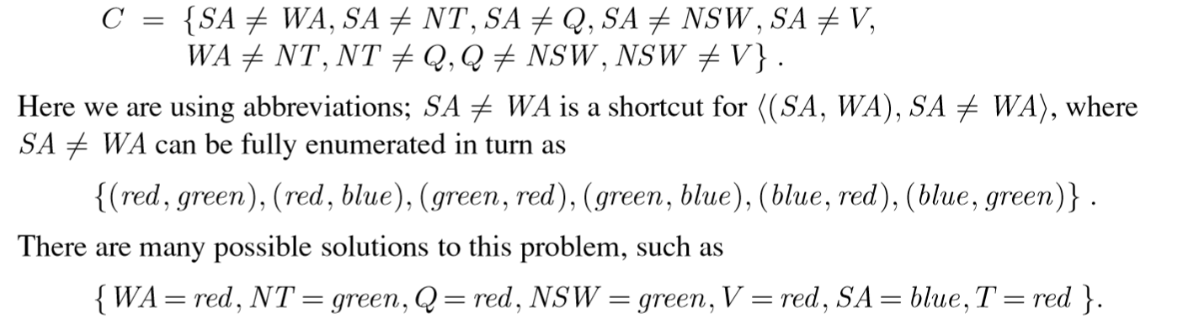
Contd..

Slide 13

Constraint graph
Binary CSP: each constraint relates two variables
Constraint graph: nodes are variables, arcs are constraints

Slide 14
Varieties of constraints
Unary constraints involve a single variable,
  e.g., SA ≠ green
Binary constraints involve pairs of variables,
  e.g., SA ≠ WA
Higher-order constraints involve 3 or more variables,
Between(X,Y,Z)
  e.g., SA ≠ WA ≠ NT

Slide 15

Example: Cryptarithmetic
Variables: F T U W R O X₁ X₂ X₃
Domains: {0,1,2,3,4,5,6,7,8,9} {0,1}
Constraints: Alldiff (F,T,U,W,R,O)
  O + O = R + 10 · X₁
  X₁ + W + W = U + 10 · X₂
  X₂ + T + T = O + 10 · X₃
  X₃ = F, T ≠ 0, F ≠ 0

Slide 16
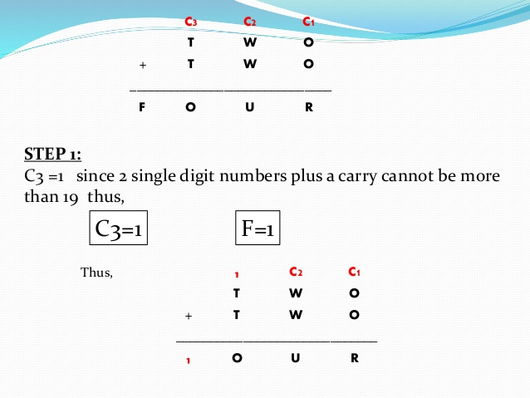
Cryptarithmetic

Slide 17
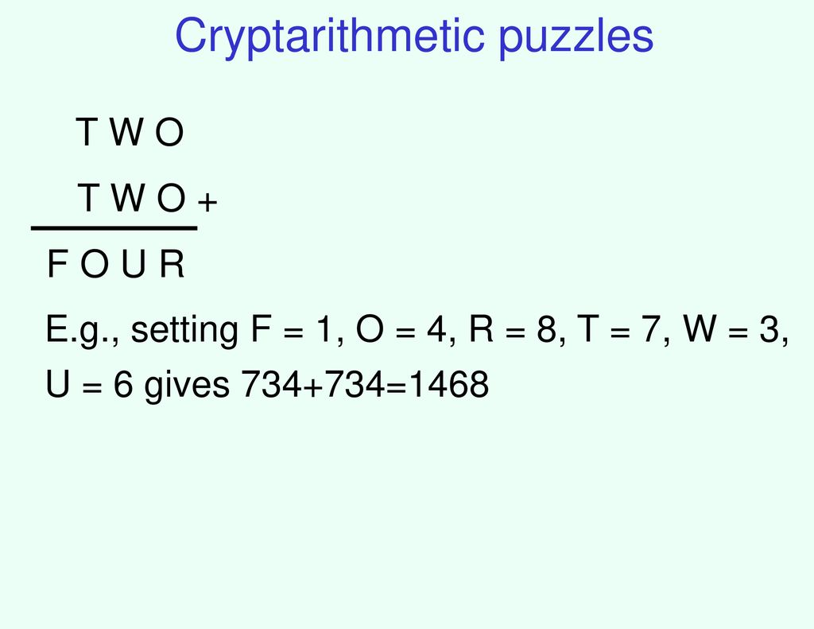
Cryptarithmetic

Slide 18
Constraint Propagation :Inference in CSPs
In CSPs there is a choice: an algorithm can search (choose a new variable assignment from several possibilities) or do a speciﬁc type of inference called constraint propagation
using the constraints to reduce the number of legal values for a variable, which in turn can reduce the legal values for another variable, and so on.

Slide 19
Node Consistency
A single variable (corresponding to a node in the CSP network) is node-consistent if all the values in the variable’s domain satisfy the variable’s unary constraints.
For example, in the variant of the Australia map-coloring problem where South Australians dislike green
Ex: SA !={green}

Slide 20
Contd
The variable SA starts with domain {red,green,blue}, and
we can make it node consistent by eliminating green, leaving SA with the reduced domain {red,blue}

Slide 21
Arc Consistency
A variable in a CSP is arc-consistent if every value in its domain satisﬁes the variable’s binary constraints.
More formally, Xi is arc-consistent with respect to another variable Xj if for every value in the current domain Di there is some value in the domain Dj that satisﬁes the binary constraint on the arc (Xi,Xj).

Slide 22
Cond..
A network is arc-consistent if every variable is arc consistent with every other variable.
For example, consider the constraint Y= X*X where the domain of both X and Y is the set of digits. We can write this constraint explicitly as
(X,Y ),{(0,0),(1,1),(2,4),(3,9))} .

Slide 23

Arc consistency
Simplest form of propagation makes each arc consistent
X →Y is consistent iff
  for every value x of X there is some allowed y
inconsistent arc.
remove blue from source→ consistent arc.

Slide 24

Arc consistency
Simplest form of propagation makes each arc consistent
X →Y is consistent iff
  for every value x of X there is some allowed y
If X loses a value, neighbors of X need to be rechecked:
i.e. incoming arcs can become inconsistent again
(outgoing arcs will stay consistent).
this arc just became inconsistent

Slide 25

Arc consistency
Simplest form of propagation makes each arc consistent
X →Y is consistent iff
  for every value x of X there is some allowed y
If X loses a value, neighbors of X need to be rechecked
Arc consistency detects failure earlier than forward checking
Can be run as a preprocessor or after each assignment

Slide 26
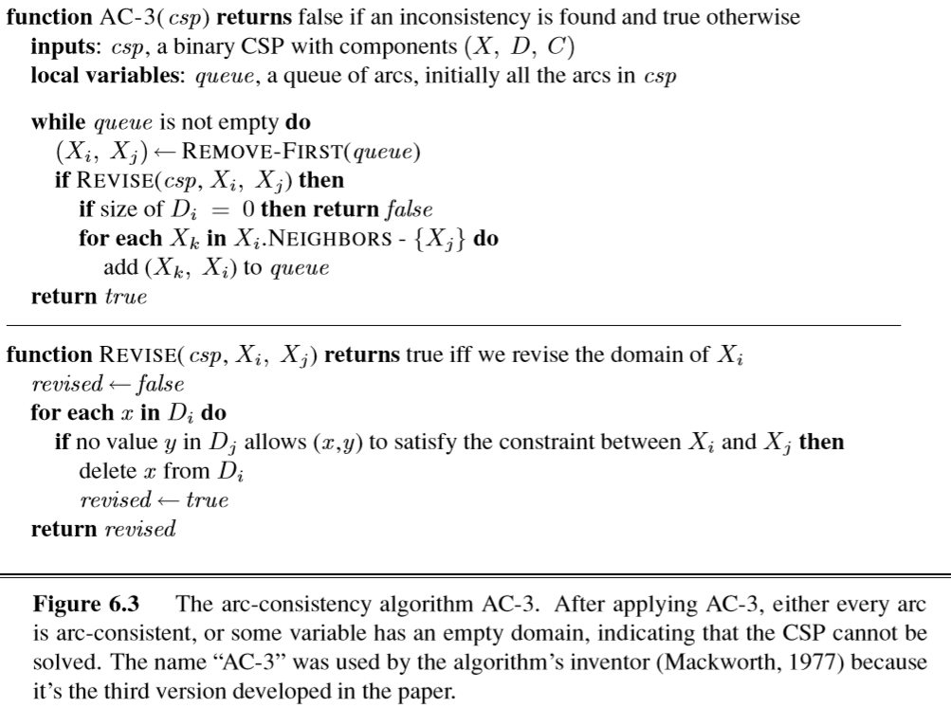
AC-3 Algorithm

Slide 27
Path Consistency
Arc consistency tightens down the domains (unary constraints) using the arcs (binary constraints).
To make progress on problems like map coloring, we need a stronger notion of consistency.
Path consistency tightens the binary constraints by using implicit constraints that are inferred by looking at triples of variables.

Slide 28
Contd..
A two-variable set {Xi,Xj} is path-consistent with respect to a third variable Xm if, for every assignment {Xi = a,Xj = b} consistent with the constraints on {Xi,Xj}, there is an assignment to Xm that satisﬁes the constraints on {Xi,Xm} and {Xm,Xj}.
This is called path consistency because one can think of it as looking at a path from Xi to Xj with Xm in the middle.

Slide 29
K Consistency
Stronger forms of propagation can be deﬁned with the notion of k-consistency.
A CSP is k-consistent if, for any set of k − 1 variables and for any consistent assignment to those variables, a consistent value can always be assigned to any kth variable.

Slide 30
Contd..
1-consistency says that, given the empty set, we can make any set of one variable consistent: this is what we called node consistency.
2-consistency is the same as arc consistency.
For binary constraint networks, 3-consistency is the same as path consistency.

Slide 31
Global Constraints
Global constraint is one involving an arbitrary number of variables (but not necessarily all variables).
Global constraints occur frequently in real problems and can be handled by special-purpose algorithms that are more efﬁcient than the general-purpose methods.

Slide 32
Contd…
For example, the Alldiﬀ constraint says that all the variables involved must have distinct values (as in the cryptarithmetic problem above and Sudoku puzzles below).
One simple form of inconsistency detection for Alldiﬀ constraints works as follows: if m variables are involved in the constraint, and if they have n possible distinct values altogether, and m>n, then the constraint cannot be satisﬁed.

Slide 33
Sudoku Example
A Sudoku board consists of 81 squares, some of which are initially ﬁlled with digits from 1 to 9.
The puzzle is to ﬁll in all the remaining squares such that no digit appears twice in any row, column, or 3×3 box (see Figure). A row, column, or box is called a unit.

Slide 34
Sudoku Example
A Sudoku puzzle can be considered a CSP with 81 variables, one for each square.
We use the variable names A1 through A9 for the top row (left to right), down to I1 through I9 for the bottom row.
The empty squares have the domain {1,2,3,4,5,6,7,8,9} and the pre-ﬁlled squares have a domain consisting of a single value.

Slide 35
There are 27 Alldiﬀ constraints: one for each row, column, and box of 9 squares.
Alldiﬀ (A1,A2,A3,A4,A5,A6,A7,A8,A9)
Alldiﬀ (B1,B2,B3,B4,B5,B6,B7,B8,B9)
···
Alldiﬀ (A1,B1,C1,D1,E1,F1,G1,H1,I1)
Alldiﬀ (A2,B2,C2,D2,E2,F2,G2,H2,I2)
···
Alldiﬀ (A1,A2,A3,B1,B2,B3,C1,C2,C3)
Alldiﬀ (A4,A5,A6,B4,B5,B6,C4,C5,C6)
···

Slide 36
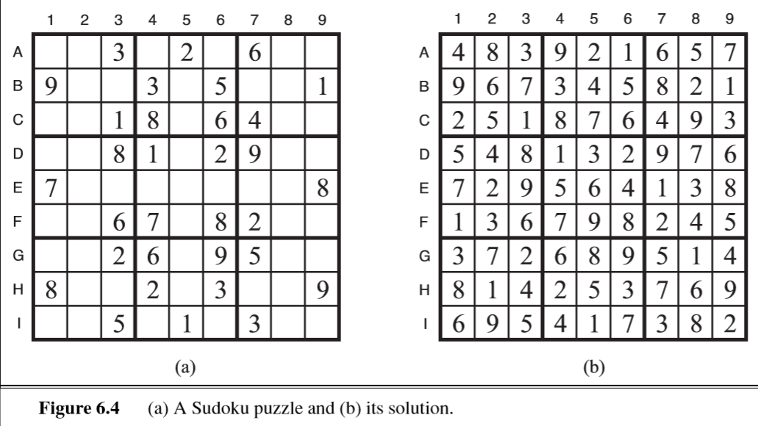
Sudoku Example

Slide 37
Sudoku Example
Assume that the Alldiﬀ constraints have been expanded into binary constraints (suchas A1!= A2) so that we can apply the AC-3 algorithm directly.
Consider variable E6 from Figure 6.4(a)—the empty square between the 2 and the 8 in the middle box.

Slide 38
Sudoku Example
From the constraints in the box, we can remove not only 2 and 8 but also 1 and 7 from E6’s domain.
From the constraints in its column, we can eliminate 5, 6, 2, 8, 9, and 3. That leaves E6 with a domain of {4}; in other words, we know the answer for E6.

Slide 39
Now consider variable I6—the square in the bottom middle box surrounded by 1, 3, and 3.
Applying arc consistency in its column, we eliminate 5, 6, 2, 4 (since we now know E6 must be 4), 8, 9, and 3.
We eliminate 1 by arc consistency with I5, and we are left with only the value 7 in the domain of I6.
Now there are 8 known values in column 6, so arc consistency can infer that A6 must be 1.

Slide 40
Backtracking (Depth-First) search
Special property of CSPs: They are commutative:
This means: the order in which we assign variables
does not matter.
Search tree: First order variables, then assign them values one-by-one.
NT
WA
=
WA
NT
D
WA
WA
WA
WA
NT
D^2
WA
NT
WA
NT
D^N

Slide 41
Backtracking Search for CSPs
The root node of a search tree for coloring the map of Australia, we might make a choice between SA=red, SA=green, and SA=blue, but we would never choose between SA=red and WA =blue.
The term backtracking search is used for a depth-ﬁrst search that chooses values for one variable at a time and backtracks when a variable has no legal values left to assign.

Slide 42
Contd..
The algorithm is shown in Figure. It repeatedly chooses an unassigned variable, and then tries all values in the domain of that variable in turn, trying to ﬁnd a solution.
If an inconsistency is detected, then BACKTRACK returns failure, causing the previous call to try another value.

Slide 43
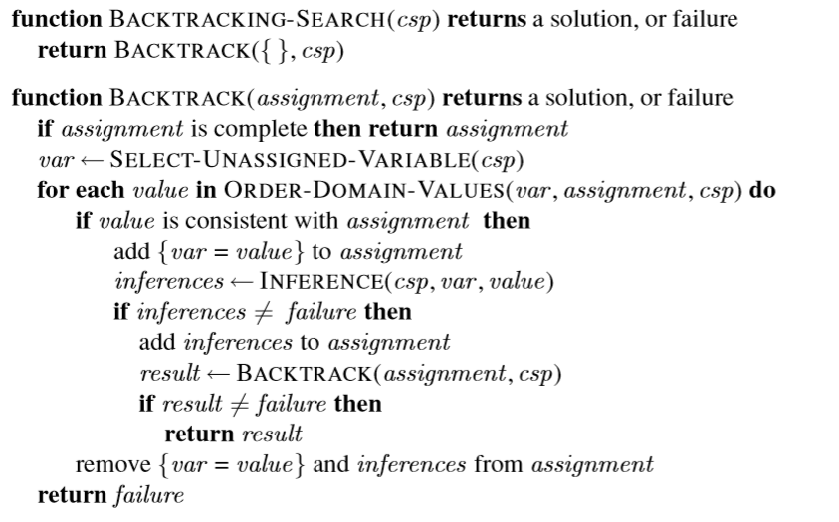

Slide 44

Backtracking example

Slide 45

Backtracking example

Slide 46

Backtracking example

Slide 47

Backtracking example

Slide 48
Improving backtracking efficiency
General-purpose methods can give huge gains in speed:
  Which variable should be assigned next?
  In what order should its values be tried?
  Can we detect inevitable failure early?
  We’ll discuss heuristics for all these questions in the following.

Slide 49
Variable and Value ordering
The simplest strategy for is to choose the next unassigned variable in order, {X1,X2,...}.
This static variable ordering seldom results in the most efficient search.
For example, after the assignments for WA =red and NT =green, there is only one possible value for SA, so it makes sense to assign SA=blue next rather than assigning Q.

Slide 50
Contd..
In fact, after SA is assigned, the choices for Q, NSW, and V are all forced.
This intuitive idea—choosing the variable with the fewest “legal” values—is called the minimum remaining-values (MRV) heuristic.

Slide 51

Which variable should be assigned next?
→minimum remaining values heuristic
Most constrained variable:
  choose the variable with the fewest legal values
a.k.a. minimum remaining values (MRV) heuristic

Slide 52

Which variable should be assigned next? → degree heuristic
Tie-breaker among most constrained variables
Most constraining variable:
  choose the variable with the most constraints on remaining variables (most edges in graph)

Slide 53
Degree Heuristic
It attempts to reduce the branching factor on future choices by selecting the variable that is involved in the largest number of constraints on other unassigned variables.
In Figure, SA is the variable with highest degree, 5; the other variables have degree 2 or 3, except for T, which has degree 0.
The minimum remaining values heuristic is usually a more powerful guide, but the degree heuristic can be useful as a tie-breaker.

Slide 54

In what order should its values be tried?
→ least constraining value heuristic
Given a variable, choose the least constraining value:
  the one that rules out the fewest values in the remaining variables
Leaves maximal flexibility for a solution.

Slide 55

Can we detect inevitable failure early?
→ forward checking
Idea:
  Keep track of remaining legal values for unassigned variables
  that are connected to current variable.
  Terminate search when any variable has no legal values

Slide 56

Forward checking
Idea:
  Keep track of remaining legal values for unassigned variables
  Terminate search when any variable has no legal values

Slide 57

Forward checking
Idea:
  Keep track of remaining legal values for unassigned variables
  Terminate search when any variable has no legal values

Slide 58

Forward checking
Idea:
  Keep track of remaining legal values for unassigned variables
  Terminate search when any variable has no legal values

Slide 59
One of the simplest forms of inference is called forward checking.
Whenever a variable X is assigned, the forward-checking process establishes arc consistency for it: for each unassigned variable Y that is connected to X by a constraint, delete from Y ’s domain any value that is inconsistent with the value chosen for X.
Because forward checking only does arc consistency inferences, there is no reason to do forward checking if we have already done arc consistency as a preprocessing step.

Slide 60
Local search for CSPs
They use a complete-state formulation: the initial state assigns a value to every variable, and the search changes the value of one variable at a time.
For example, in the 8-queens problem, the initial state might be a random conﬁguration of 8 queens in 8 columns, and each step moves a single queen to a new position in its column.

Slide 61
Contd..
Typically, the initial guess violates several constraints. The point of local search is to eliminate the violated constraints.
In choosing a new value for a variable, the most obvious heuristic is to select the value that results in the minimum number of conﬂicts with other variables—the min-conﬂicts heurestic.

Slide 62
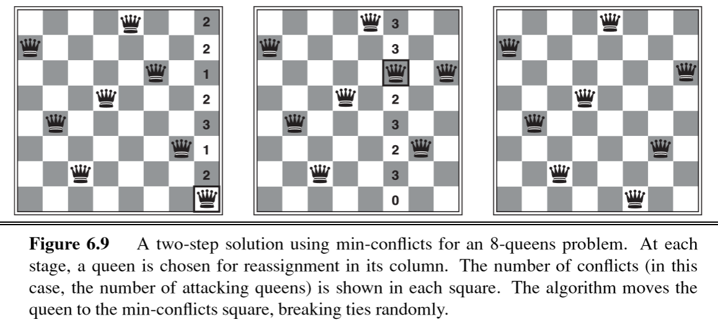

Slide 63
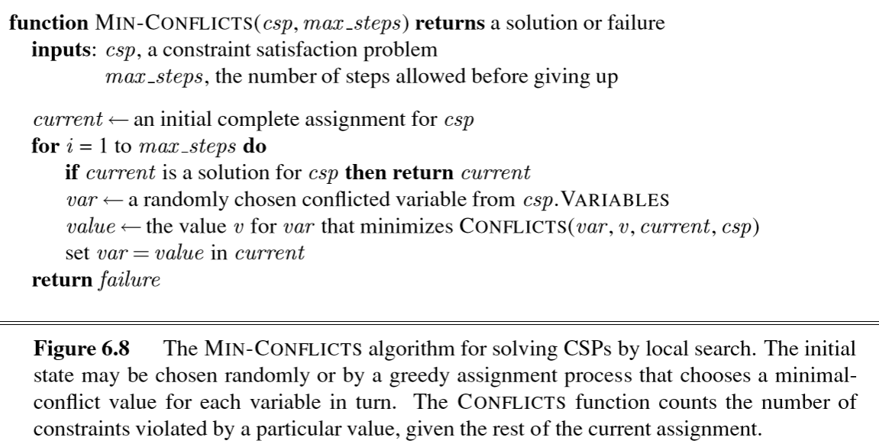

Slide 64
The Structure of Problems
The only way we can possibly hope to deal with the real world is to decompose it into many subproblems.
Looking again at the constraint graph for Australia,one fact stands out: Tasmania is not connected to the mainland.

Slide 65
Contd..
A constraint graph is a tree when any two variables are connected by only one path.
We show that any tree-structured CSP can be solved in time linear in the number of variables.
The key is a new notion of consistency, called directed arc consistency or DAC.

Slide 66
Contd..
A CSP is deﬁned to be directed arc-consistent under an ordering of variables X1,X2,...,Xn if and only if every Xi is arc-consistent with each Xj for j>i

Slide 67
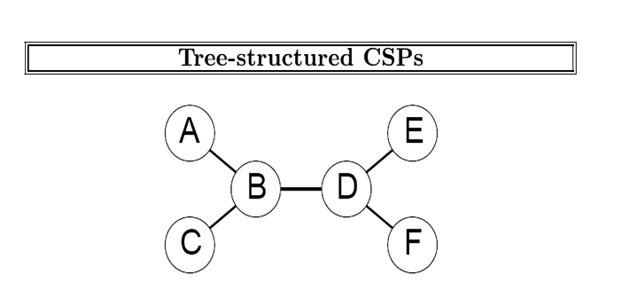

Slide 68
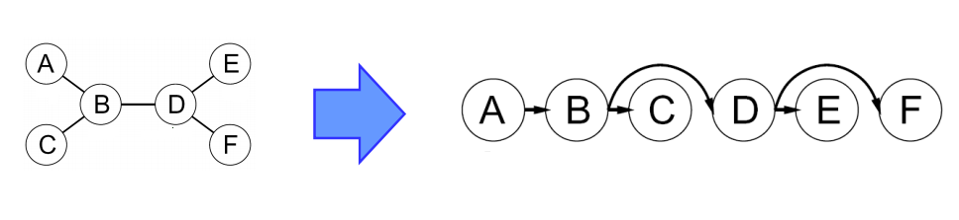
1. Choose a root variable and flatten the graph starting from the root

Slide 69
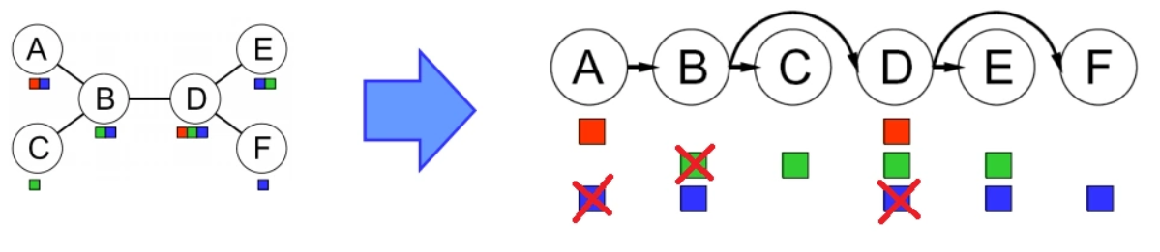
2. Perform a backward removal phase where we check arc consistency starting from the rightmost node and going backwards

Slide 70
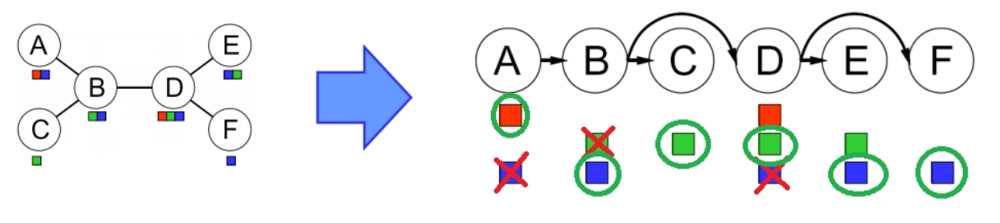
3. Perform a forward assignment phase where we select an element from the domain of each variable going left to right. We are guaranteed that there will be a valid assignment because each arc is arc consistent by way of step 2

Slide 71
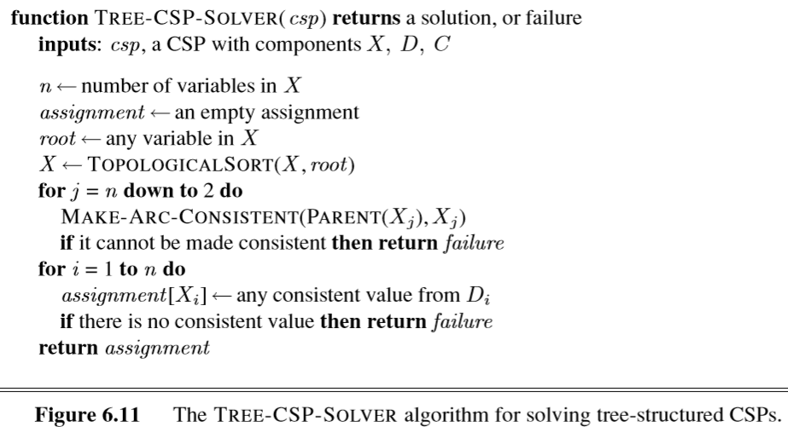
Algorithm for Tree structured CSPs

Slide 72
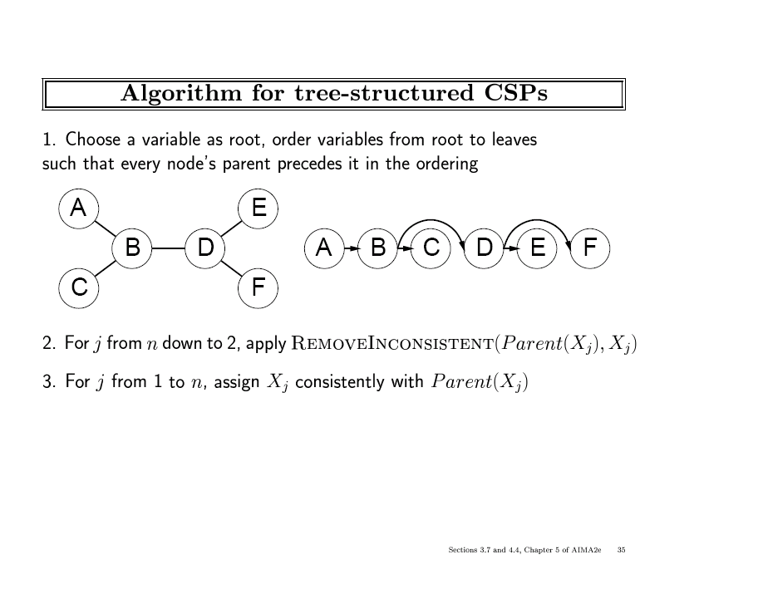
B
G
R
R
G
B
B
R
G
B
G
B
R
G
G
R
B
Note: After the backward pass, there is guaranteed
to be a legal choice for a child node for any of its
leftover values.
This removes any inconsistent values from Parent(Xj),
it applies arc-consistency moving backwards.

Slide 73
Tree Structure CSPs
We have an efficient algorithm for trees, we can consider whether more general constraint graphs can be reduced to trees somehow.
There are two primary ways to do this, one based on removing nodes and one based on collapsing nodes together.

Slide 74
Tree Structure CSPs
The ﬁrst approach involves assigning values to some variables so that the remaining variables form a tree.
Consider the constraint graph for Australia, If we could delete South Australia, the graph would become a tree, as in (b).
Fortunately, we can do this by ﬁxing a value for SA and deleting from the domains of the other variables any values that are inconsistent with the value chosen for SA.

Slide 75
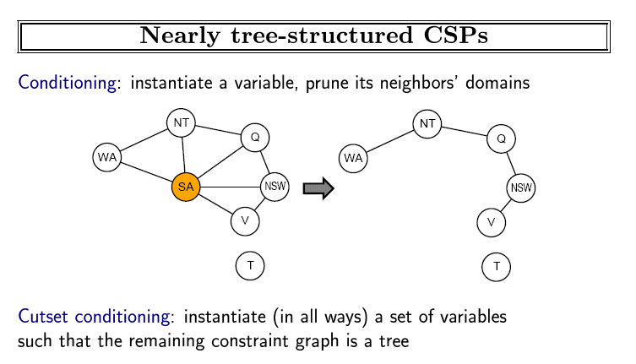

Slide 76
TREE DECOMPOSITION
The second approach is based on constructing a tree decomposition of the constraint graph into a set of connected subproblems.
Each subproblem is solved independently, and the resulting solutions are then combined.
Like most divide-and-conquer algorithms, this works well if no subproblem is too large.

Slide 77
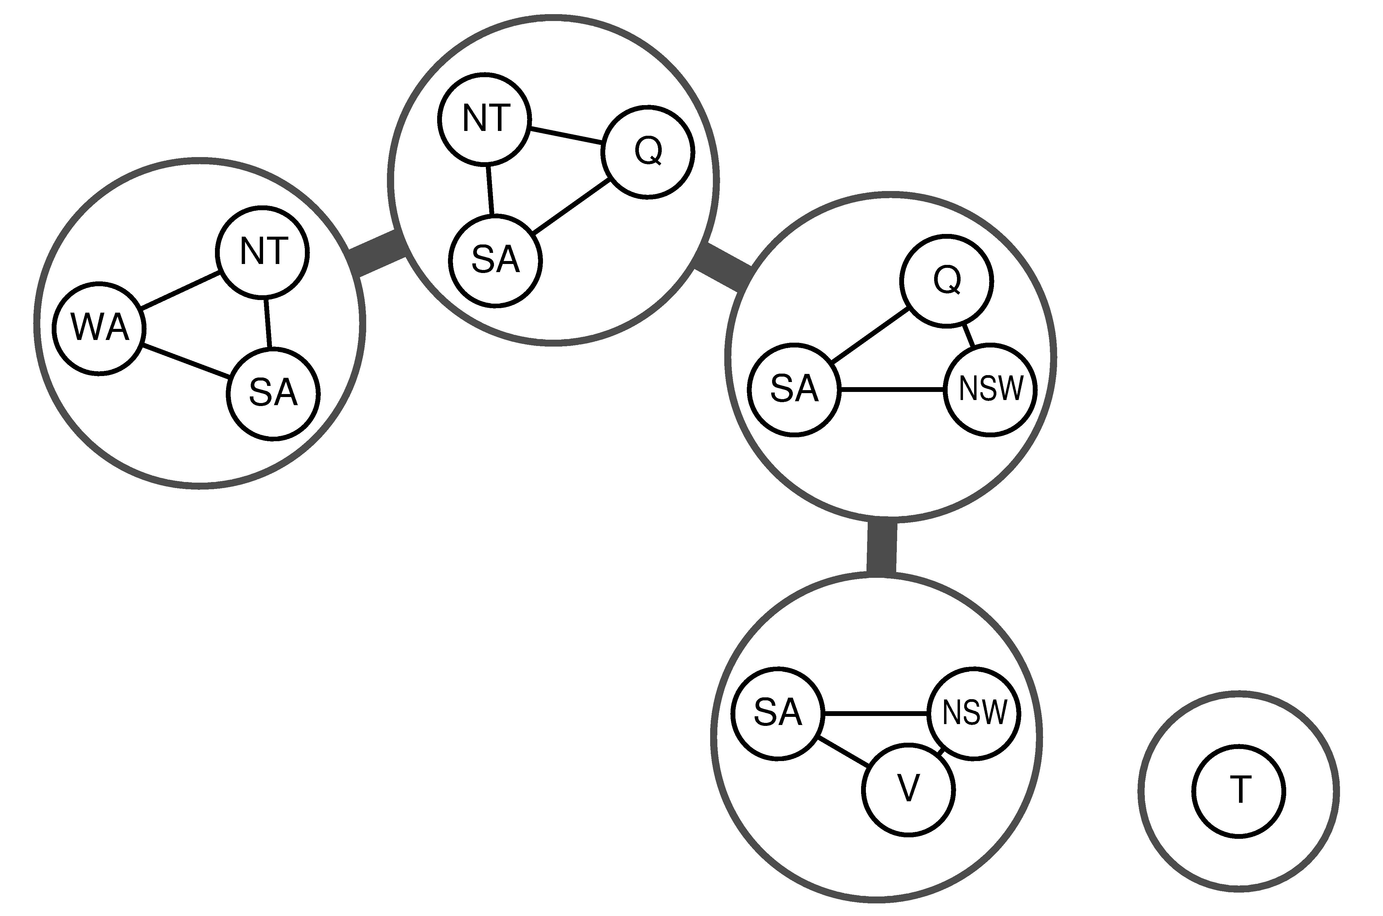
Junction Tree Decompositions

Slide 78
Tree Decomposition
We solve each subproblem independently;
if any one has no solution, we know the entire problem has no solution.
If we can solve all the subproblems, then we attempt to construct a global solution as follows.
First, we view each subproblem as a “mega-variable” whose domain is the set of all solutions for the subproblem.

Slide 79
Tree Decomposition
For example, the leftmost subproblem in Figure is a map-coloring problem with three variables and hence has six solutions—one is {WA = red, SA = blue, NT = green}.
For example, given the solution
{WA = red,SA = blue, NT = green} for the ﬁrst subproblem, the only consistent solution for the next subproblem is
{SA = blue, NT = green, Q= red}.

Slide 80
Thank you

Slide 81
Summary
CSPs are a special kind of search problem:
  states defined by values of a fixed set of variables
  goal test defined by constraints on variable values
Backtracking = depth-first search with one variable assigned per level.
Variable ordering and value selection heuristics help significantly
Forward checking prevents assignments that guarantee later failure
Constraint propagation (e.g., arc consistency) does additional work to constrain values and detect inconsistencies
Iterative min-conflicts is usually effective in practice

